Slide 1


2025 Benefits Open Enrollment
Open Enrollment: November 4 – 15, 2024

Slide 2

What We’ll Cover Today
1
Reviewing the Basics: Open Enrollment Overview
Learning What’s New: Key Changes for 2025
Understanding Your Options: Benefits Overview
Finding What Fits: People Like You
Knowing Where to Go: Your Resources
2
3
4
5

Slide 3
Open Enrollment Overview
This year’s Open Enrollment window is: November 4 – November 15, 2024
Make changes to any of your coverages, based on your needs
Add or remove dependents
Review and update your beneficiaries
Make contribution elections to the HSA if you choose one of our HDHP medical options
Contribute to the Health Care FSA if you do not enroll in an HDHP
Contribute to the Dependent Care FSA
Confirm or make your Supplemental Life election
Flexible Spending Account elections do NOT carry over from year to year. You must make new elections!

Slide 4
How to Enroll
SMP Benefits: Dayforce
www.DayforceHCM.com
New user:
Company: smp
Username: first.last
Password: [BirthYear][Last4SSN]’Login’ Example: 19701234Login
Be sure to use your full legal first and last name when you create your account. You will then be asked to reset your password.
Returning user:
Log in using the same username and password you use to view your paystubs.
From the Home Screen, click the Benefits icon then Start Enrollment on the Benefits Overview page.
Voluntary Benefits: Reliance Matrix
www.DayforceHCM.com
Consider voluntary benefits through Reliance Standard.
Enroll yourself, your spouse, and child(ren) for:
Accident Insurance
Critical Illness Insurance
Hospital Indemnity
Enroll yourself only for:
Short Term Disability
Permanent Life Insurance + Long Term Care: AGIS
smpltc.com
Enroll in this new benefit designed to help pay for the cost of long term care.
Visit the site to learn more, calculate your rates, and apply for coverage.
Tip: This Open Enrollment is your one-time opportunity to secure coverage with no medical questions or exams required for eligible employees through age 70.

Slide 5

Key Changes for 2025
New coverage categories for medical, dental, and vision benefits
Medical plan changes
Prescription drug network enhancements
Simplified wellness program requirements
New permanent life insurance + LTC benefit

Slide 6
Key Changes for 2025
New Coverage Categories
Medical Plan Changes
Moving from three to four categories
More control over your costs with categories that more closely reflect your needs
Based on who you choose to cover under medical, dental, and vision plans
Employee Only
Employee Plus Spouse
Employee Plus Children
Employee Plus Family
Your payroll deductions may increase or decrease based on your new category
Three medical plan options
No changes to HDHP Base or HDHP Value
Simplified costs for office visits in the PPO:
Moving from 10% coinsurance to flat copay
$25 primary care visits
$40 specialist visits
What’s Not Changing?
Dental benefits
Vision benefits
Company-provided disability and life insurance

Slide 7
Key Changes for 2025
Prescription Drug Network
Simplified Wellness Program
Enhancements to bring you more choice and flexibility
Switching to Retail 90 Network with Carelon
Expanded network has more retail pharmacies throughout the country—including Walmart!
More flexibility to get a 90-day supply of maintenance medication for same cost as mail order at more than 26,000 retail pharmacies nationwide (not limited to CVS!)
Refocused on the best way for you to stay on top of your health while saving money
Removing health risk questionnaire and biometric screening
Only requirement is annual preventive care exam (well woman exam meets requirement)
You (and your spouse, if covered) must complete annual preventive exam between October 16, 2024 and October 15, 2025

Slide 8
Key Changes for 2025
New Permanent Life Insurance + Long Term Care Benefit Offering
Employee-paid, voluntary benefit
Two benefits in one policy:
Rates based on age when coverage begins – and never increase
Your spouse is eligible if you apply for coverage
This Open Enrollment is your one-time opportunity for Guaranteed Issue (no medical exam)
Permanent Life Insurance
Permanent coverage
Can be used to pay final expenses
Helps protect your financial legacy
Long Term Care (LTC)
Relieve family from becoming full-time caregivers
Cash benefits for home and/or residential care
Decide where and from whom you receive care

Slide 9

Benefits Overview Eligibility
You are eligible for SMP benefits if you regularly work at least 30 hours per week
You may also cover the following dependents:
Your legal spouse
Your natural, adopted, foster, or stepchildren (up to December 31 of the year they reach 26)
Children of any age who become mentally or physically disabled before age 26

Slide 10

Benefits Overview Medical & Prescription Drug Coverage
Three medical plan options administered by Anthem BCBS
Preventive care is free in-network
All plans have an annual deductible
Two HDHP options come with a Health Savings Account (HSA)
All plans offer you the ability to get care from ANYWHERE!
With Anthem’s SydneySM Health App, you can see doctors from anywhere.
Need urgent care? Choose LiveHealth Online for 24/7 visits without an appointment.
Need ongoing care? Choose Virtual Primary Care for regular check-ups and ongoing health needs.
Go to sydneyhealth.com to download today!

Slide 11
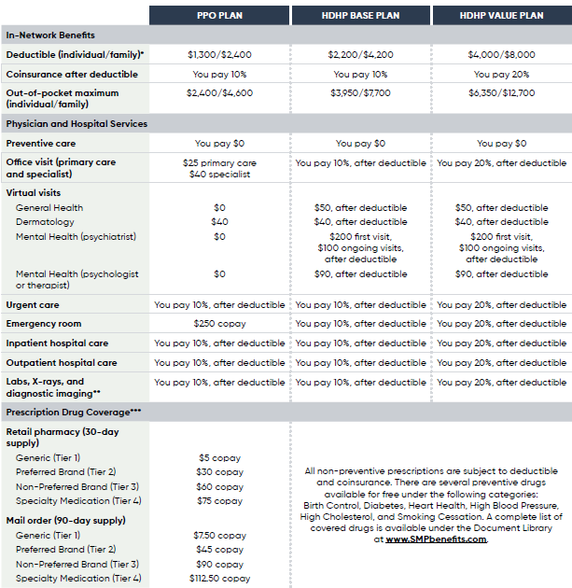
Benefits Overview Medical & Prescription Drug Coverage
All three plans offer the choice to visit any provider
In-network providers will generally cost you less
See the Benefit-at-a-Glance or visit www.SMPbenefits.com for out-of-network benefit details
* Under both HDHP options, the family deductible is a combined deductible. That means if you cover any dependents, all collective claims under the plan must meet the full deductible before coinsurance begins. Once the total member responsibility exceeds the deductible, the entire family begins to pay coinsurance.
** If your doctor recommends a high-tech imaging service, such as an MRI/CT scan, you must get prior authorization for these services, or you will be subject to a $50 penalty. If you need a high-tech imaging service, have your doctor call 1-888-953-6703 (the same number on the back of your Medical ID card).
*** There is a Tiered Pharmacy Surcharge for using a Level 2 Pharmacy

Slide 12
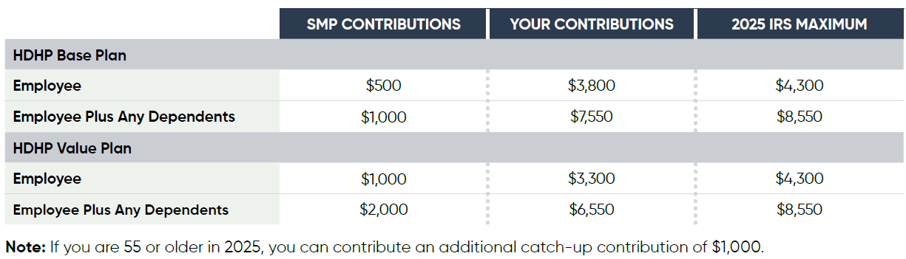
Benefits Overview Health Savings Account
1
You and SMP contribute to an HSA
In addition to SMP contributions, you can contribute on a pre-tax basis via payroll contributions. It’s a lot like contributing to the 401(k) Plan — but for health care costs.
You get access to an HSA if you choose one of our two HDHP medical options
SMP will contribute to your HSA, based on which plan you choose + who you cover
Once you have a balance of $1,000, you can begin to invest in mutual funds like the 401(k) Plan
2
Accounts grow tax-free
It’s tax-free as it grows, as any interest or investment earnings aren’t subject to taxes.
3
You make tax-free withdrawals
When you withdraw funds from your account to use for eligible health care expenses, those withdrawals are tax-free.

Slide 13
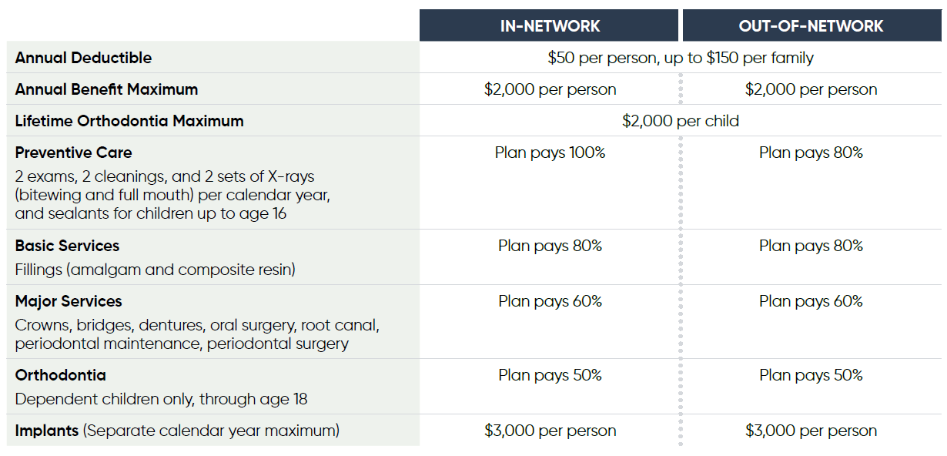
Benefits Overview Dental Coverage

Slide 14
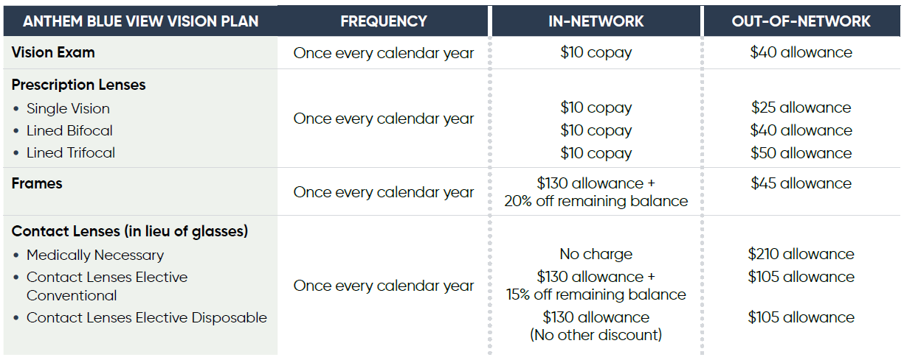
Benefits Overview Vision Coverage

Slide 15
Benefits Overview Tax-Advantaged Accounts
Health Care FSA | Dependent Care FSA
Set aside pre-tax dollars to pay for health care costs not covered by insurance, including copayments, coinsurance and deductibles – as well as everyday items from sunscreen to baby care, feminine care products and over-the-counter medicines | Set aside pre-tax dollars to pay for certain dependent care costs that enable you and your spouse to work or look for work – like nursery school, licensed day care centers, summer day camps and in-home care
Maximum contribution is $3,200 for 2024. | Maximum contribution set by the IRS is $5,000.
If you enroll in one of the HDHP options, you are not eligible to enroll in the Health Care FSA.
FSAs are “use it or lose it.”

Slide 16
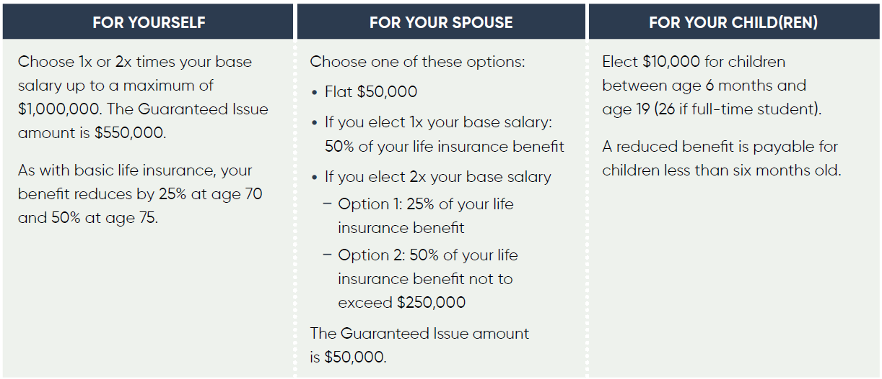
Benefits Overview Life Insurance
Offered through Reliance Matrix
Company-provided Basic Life and AD&D of 1.5 times your base salary, up to a maximum of $1,000,000, at no cost to you.
Supplemental Life you can buy through payroll deductions

Slide 17

Benefits Overview Disability and Leave Benefits
Short Term Disability (STD) – if you are absent from work for more than three days in a row
Salary Continuation – number of weeks based on your years of service
Long Term Disability (LTD) – if your disability continues beyond the STD benefit period
FMLA – available in addition disability benefits for certain family and medical reasons
Enrollment is not required. You will participate in these benefits automatically based on your status and years of service. For information, contact your local Human Resources representative.

Slide 18
Benefits Overview Voluntary Benefits
Accident Insurance
Pays for treatments or injuries resulting from a covered accident. It can help you pay for rehab, transportation, travel, or other out-of-pocket costs.
Hospital Indemnity
Pays benefits after a qualified hospitalization.
Critical Illness Insurance
Provides a lump-sum benefit for diagnosis of a covered critical illness or event like a heart attack or stroke. It can help cover travel, room and board, transportation, and more.
Short Term Disability
The opportunity to provide additional benefits beyond the company-provided STD – so you can increase your weekly benefit during your STD.
Permanent Life Insurance + Long Term Care
Two benefits in one policy. Permanent Life Insurance can be used to pay final expenses and helps protect your financial legacy. Long Term Care (LTC) can relieve your family from becoming full-time caregivers and provides cash benefits for home care and/or residential care.

Slide 19
Benefits Overview Personal & Well-Being Benefits
Emotional Support from Spring Health
Menopause & Midlife Care from Progyny
High-quality, personalized care from diverse providers
No cost to non-union, full-time employees and dependents
Four free therapy sessions (for you and your family members ages 6 and older) and four free coaching sessions (for you and your family members ages 18 and older) per year
Also includes self-guided mental wellness exercises, work-life services, medication management, substance use support, and more
Virtual care for all stages of menopause
Combination of hormonal and non-hormonal treatments, nutrition and weight management, sleep support, mental health care, and more
Premier fertility benefit designed to provide all-inclusive comprehensive coverage
Patient Care Advocates offer education, support, and coordinated care
Full suite of fertility treatment options, including Artificial Insemination (IUI), Cryopreservation, Fresh IVF Cycle, Frozen Embryo transfer (FET), Frozen Oocyte Transfer, donor tissue (eggs and sperm) purchase
Family Planning Support from Progyny

Slide 20
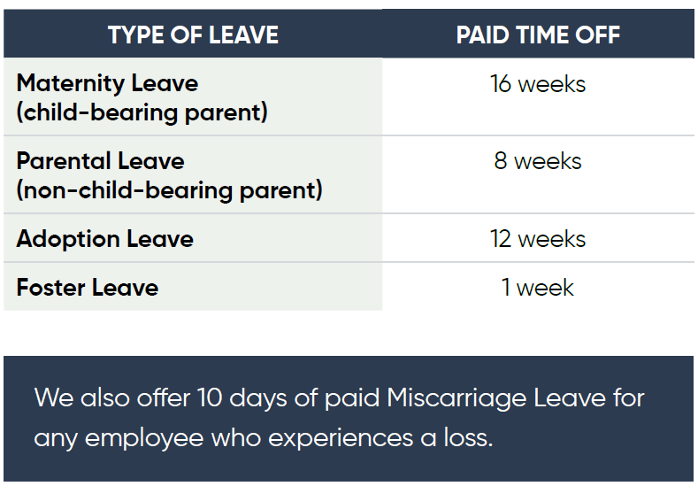

Benefits Overview Time Off Benefits

Slide 21
Benefits Overview Fidelity Retirement Benefits
401(k) Plan
Eligibility | First day of the next calendar quarter after completing 30 days of service
Your Contributions | Automatic enrollment at 6% of eligible pay (pre-tax) Contributions increase by 2% every year you contribute less than 12% You can choose a different rate
SMP Contributions | SMP makes a 3% contribution based on your compensation, regardless of your contributions SMP also makes an additional profit-sharing contribution based on our performance
ESOP
Eligibility | First day of the next calendar quarter after completing 1,000 hours of service
SMP Contributions | SMP makes a discretionary contribution, divided among eligible participants Your “share” is based on years of service + compensation SMP contribution deposits on or about March 15 of the following year
Vesting | Less than 2 years service. . . . . . . . . .0% 2 years service. . . . . . . . . . . . . . . . . 20% 3 years service. . . . . . . . . . . . . . . . . 40% 4 years service . . . . . . . . . . . . . . . . .60% 5 years service. . . . . . . . . . . . . . . . . 80% 6 years service. . . . . . . . . . . . . . . . 100%

Slide 22
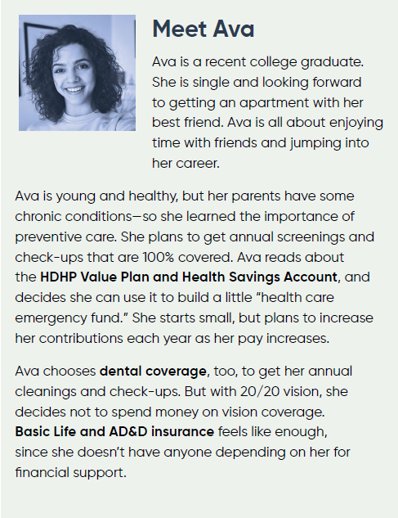
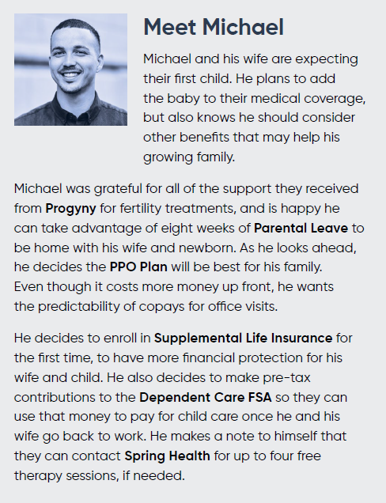
People Like You

Slide 23
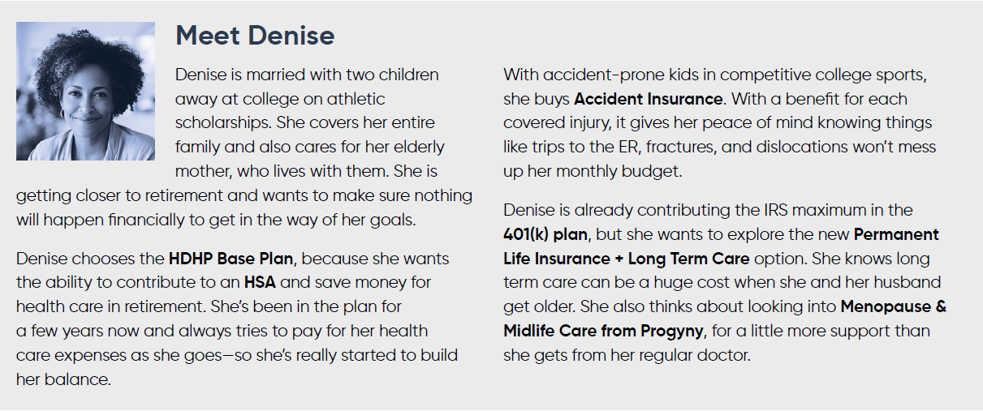
People Like You

Slide 24


Your Resources
www.SMPbenefits.com
www.DayforceHCM.com
For…
Finding detailed information about benefit plans
Getting links to forms and Summary Plan Descriptions
Reading timely news and articles
And more!
For…
Reviewing your current coverage
Making new benefit elections or changes
Updating or adding beneficiaries

Slide 25


Thank you!

